Slide 1

EMPATHY AND EMOTION ANALYSIS
HIT-SCIR at WASSA 2023: Empathy and Emotion Analysis
Authors: Xin Lu, Zhuojun Li, Yanpeng Tong, Yanyan Zhao, Bing Qin
Affiliation: Research Center for Social Computing & IR, HIT
Venue: WASSA 2023, July 14, 2023
Presented By:
Gautam Siwach
Jasmin Bargir
Kiranmayi Modugu

Slide 2

Introduction
Rise of empathy & emotion analysis in conversational AI
Importance: improves HCI and user satisfaction
Paper participates in 3 tracks (CONV, EMP, EMO)

Slide 3

Background & Problem
Tasks: empathy prediction, emotion detection, distress prediction
Why it matters: emotional understanding improves AI
Challenges: context modeling, imbalance, correlation

Slide 4
Literature Review
Past: BERT, RoBERTa, manual features.
Limitations: weak context modeling, poor generalization
Research gap: multi-task learning & augmentation

Slide 5

Research Tracks Overview
Track 1
Track 2
Track 3
Utterance-level regression
(DeBERTa)
Essay-level
empathy/distress
(RoBERTa MTL)
Emotion classification (RoBERTa + BiLSTM + augmentation)

Slide 6

Track 1 Methodology
DeBERTa-xl/xxl fine-tuning
Uses context windows for dialogue representation
Regression outputs for polarity, intensity, empathy

Slide 7
Track 1
Architecture
Input formatting with context windows
Encoder → CLS pooling → MLP
Window size selection based on dev performance

Slide 8
Track 2
Methodology
Empathy & distress highly correlated (0.63)
Multi-task learning with shared RoBERTa
Two MLP heads for separate predictions

Slide 9
Track 2 Architecture
Shared encoder → task-specific heads
CLS token representation
Equal-weighted loss training

Slide 10




Track 3 Methodology
Small, imbalanced dataset
ChatGPT-based data augmentation
RoBERTa-large + BiLSTM classifier

Slide 11

Track 3
Architecture
RoBERTa encoding → BiLSTM → pooling → MLP
Sigmoid for multi-label classification

Slide 12

Results Summary
Track 1: Best performer (Avg Pearson 0.758)
Track 2: Moderate performance (0.3416)
Track 3: Macro F1 = 0.644

Slide 13
Evaluation Discussion
Strengths: strong context modeling, MTL success, augmentation helpful
Weaknesses: test-set shift, rare-label difficulty
High computation requirements

Slide 14
Critical Analysis
Strengths: systematic design, ensemble filtering
Weaknesses: large-model dependency
Impact: improved benchmarks & modeling strategies

Slide 15
Future Work & Conclusion
Future: domain adaptation, improved augmentation
Lightweight models for deployment
Conclusion: effective multi-model, multi-level approach

Slide 16
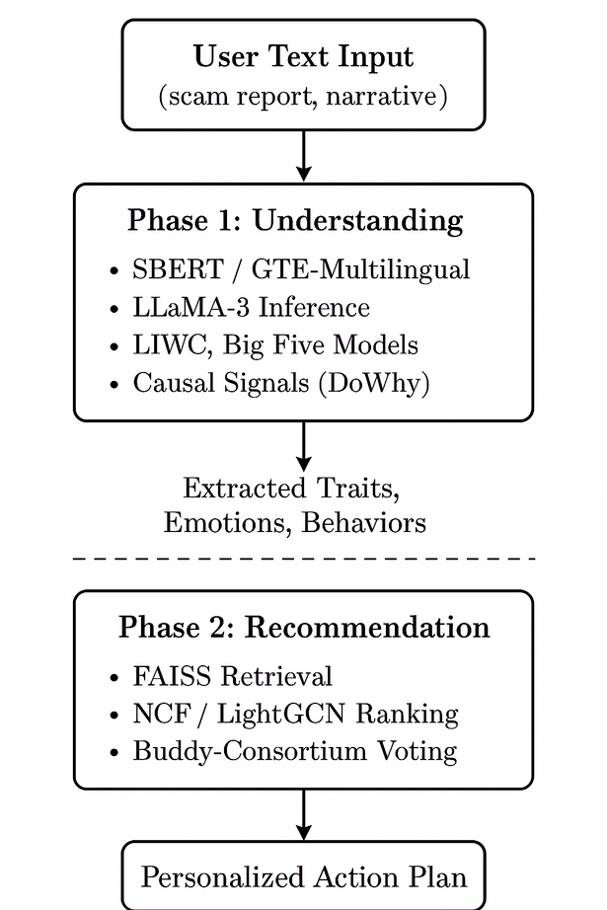
Model

Slide 17
References
CORE MODELS & EMBEDDINGS
.REIMERS, N., & GUREVYCH, I. (2019). SENTENCE-BERT: SENTENCE EMBEDDINGS USING SIAMESE BERT-NETWORKS.
SU, J., ET AL. (2023). GTE: GENERAL TEXT EMBEDDINGS FOR MULTILINGUAL UNDERSTANDING.
WANG, S., ET AL. (2024). E5-MISTRAL: ENHANCED EMBEDDING MODELS.
LLMS FOR COGNITIVE UNDERSTANDING
4. TOUVRON, H., ET AL. (2024). LLAMA 3.
5. BAI, J., ET AL. (2024). QWEN2 LANGUAGE MODELS.
PSYCHOLOGICAL & BEHAVIORAL MODELING
6. PENNEBAKER, J. W., BOOTH, R. J., & FRANCIS, M. E. (2015). LIWC2015.
7. GOLDBERG, L. R. (1992). BIG FIVE PERSONALITY MARKERS.
CAUSAL & GRAPH REASONING
8. SHANMUGAM, K., ET AL. (2020). DOWHY: A CAUSAL INFERENCE FRAMEWORK.
9. CAUSALNEX TEAM. (2020). CAUSALNEX: BAYESIAN NETWORKS FOR CAUSAL MODELING.
RECOMMENDATION MODELS
10. HE, X., ET AL. (2017). NEURAL COLLABORATIVE FILTERING (NCF).
11. WANG, X., ET AL. (2019). LIGHTGCN: SIMPLIFYING AND POWERING GRAPH CONVOLUTION NETWORKS.
12. JOHNSON, J., ET AL. (2019). FAISS: EFFICIENT SIMILARITY SEARCH AT SCALE.

Slide 18
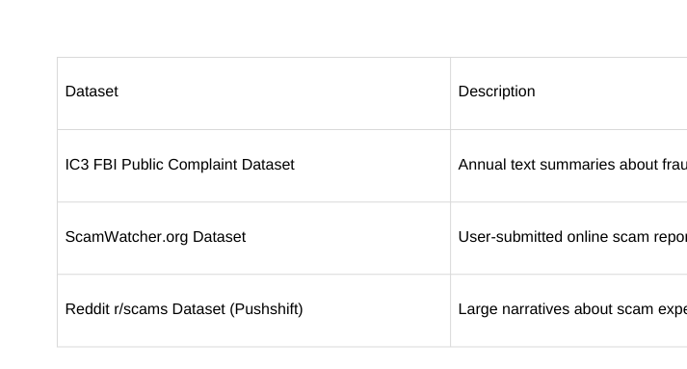
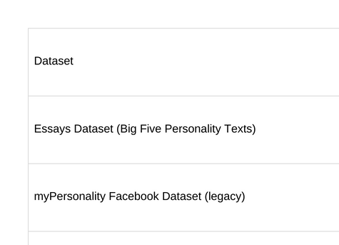
Dataset
A. SCAM / FRAUD NARRATIVE DATASETS
B. PERSONALITY / PSYCHOLOGICAL DATASETS

Slide 19
SYSTEM SUMMARY – END-TO-END WORKFLOW
Summary of Key Results (Understanding + Recommendation Modules)
Imagine a user, Alex, who has just experienced an online scam and writes a narrative filled with fear, frustration, and uncertainty.
The Understanding Module processes this raw text using SBERT to generate a rich semantic embedding, while conceptual LIWC and Big Five signals highlight high Negative Emotion, Anxiety, and Neuroticism, with a need for structured guidance.
These linguistic + psychological cues are merged into a unified user embedding, representing Alex’s emotional state, cognitive needs, and situational context.
This embedding flows into the Recommendation Module, where a FAISS similarity search compares Alex’s profile to a library of indexed support resources.
The system returns highly personalized recommendations — e.g., stress-reduction techniques, legal rights documentation, or expert consultation options — each aligned with Alex’s emotional and informational needs.
T

Slide 20
UNDERSTANDING MODULE – RESULTS
Environment Setup & Embedding Generation
Installed sentence-transformers and loaded SBERT all-MiniLM-L6-v2.
Successfully generated 384-dimensional semantic embeddings capturing contextual meaning from user narratives (frustration, sadness, anger, fear).
Conceptual Trait Extraction (LIWC + Big Five)
LIWC indicators:
Negative Emotion: High
Anxiety: High
Anger: Present
Sadness: Present
Cognitive Processes: Moderate
Social Processes: Low
Big Five conceptual traits:
Neuroticism: High
Agreeableness: Moderate
Openness: Moderate
Conscientiousness: Moderate
Extraversion: Low
Outcome:
A rich psychological-linguistic representation that becomes the unified user embedding used in downstream recommendation.
T

Slide 21
RECOMMENDATION MODULE – RESULTS
Setup & Embedding Preparation
Installed PyTorch, TensorFlow, FAISS-CPU.
Created synthetic user + item embeddings (396-dimensional) combining semantic, LIWC, and Big Five traits.
FAISS Personalized Recommendations
For the sample user with high anxiety and need for structure:
Mindfulness & Stress-Reduction Techniques (item_C)
Top match; aligned with user’s high anxiety + emotional instability.
Comprehensive Legal Rights Guide (item_A)
Supports need for clarity and structured decision-making.
Detailed Legal Consultation Service (item_D)
Matches cognitive needs and desire for expert guidance.
Visualization & Insights
Recommendations displayed through a clear DataFrame showing:
Rank, item_id, description
Similarity distance
Associated traits
Confirms the FAISS retrieval pipeline works effectively and produces meaningful personalized action maps.
T

Slide 22
Thank you!

